Slide 1
Reactive Real-time Scheduling Using Simulation-Optimization and Evolutionary Algorithms
Engelbert Pasieka, Sebastian Engell
CoDIT2024
Presented by Engelbert Pasieka

Slide 2
Content
Introduction to scheduling
Simulation-optimization
A new approach to EA-based reactive real-time scheduling
Case study
Results
Conclusions & outlook

Slide 3
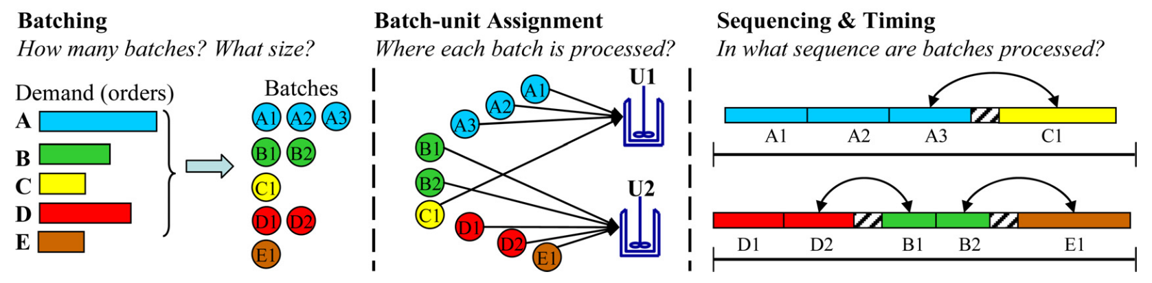
Introduction to scheduling
Scheduling is a decision making process
It is used in many domains
Production scheduling, airline scheduling, event scheduling
It decides on discrete degrees of freedom of the optimization problem, e.g.
Allocation of entities to resources
Splitting and merging of activities
Sequencing and timing of activities
Scheduling in the process industry
Batch production
Multiple products
Flexible plants
Harjunkoski, Maravelias, Bongers, Castro, Engell, Grossmann, Hooker, Méndez, Sand, Wassick: Scope for industrial applications of production scheduling models and solution methods,, Computers and Chemical Engineering, 2014, 62, 161-193
Notes:
Airline scheduling combines flight scheduling, fleet assignment, crew scheduling.

Slide 4
Simulation-optimization
Case Study: Industrial production plant (Crop protection)
Planning horizon of 1 month
~1000 batches aggregated into 28 campaigns
~20 minutes computation for a full simulation
Complex conditions and constraints
Heuristic rules for the discharging of tanks
Detailed representation of shift schedules and logistics
Uses detailed simulation models to optimize real-world processes
Handles complex systems that are difficult to model analytically
Leads to more accurate predictions and better decision-making
Rigorous scheduling methods
Difficult to represent all features
Large computation times
Expert knowledge needed to maintain the solutions

Slide 5
Our Simulation-optimization framework
Parallelization of computation
DEGREES OF FREEDOM
Scheduling System
Allocation
Assign each (sub)order to a unit
E.g.:
Sequence
Set global priorities of each order
E.g.:
Batching
Start from a set of base orders
Repair algorithms needed
E.g.:
Scheduling decisions
INOSIMCore
Extension
Discrete-Event Simulation
INOSIMCore
Evolutionary Algorithm
Extension
INOSIMCore
Extension
Objective values
Degrees
Of
Freedom
 | O1 | O2 | O3 | O4
Unit 1 | 1 | 3 | 2 | 7
Unit 2 | 5 | 6 | 4 | 3
Model
Parameters
Objective
4 | 2 | 1 | 3
Production Plant
Time
Problem Structure
Results
 | O1 | O2 | O3 | O4
#Batches | 7 | 5 | 3 | 4
[1] C. Klanke and S. Engell, ”Scheduling and batching with evolutionary algorithms in simulation-optimization of an industrial formulation plant,” Computers & Industrial Engineering, vol. 174, Dec. 2022.

Slide 6
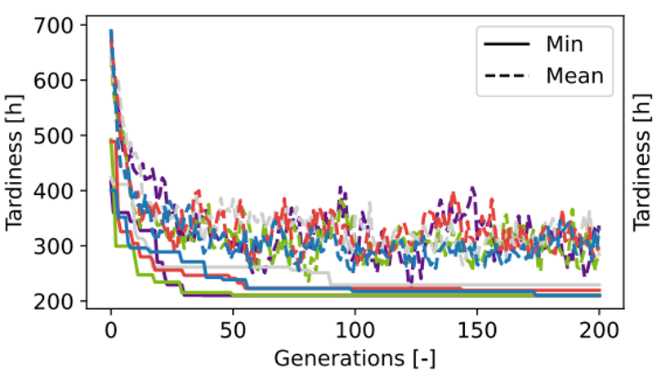
Results for the example shown before
Evolution of the quality of the schedule for five runs of the algorithm
Partial schedule

Slide 7
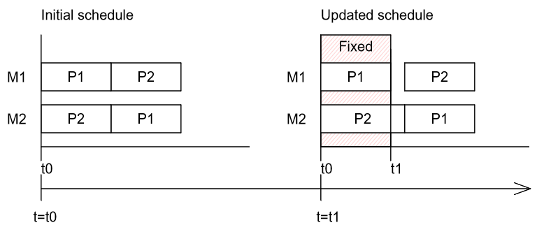
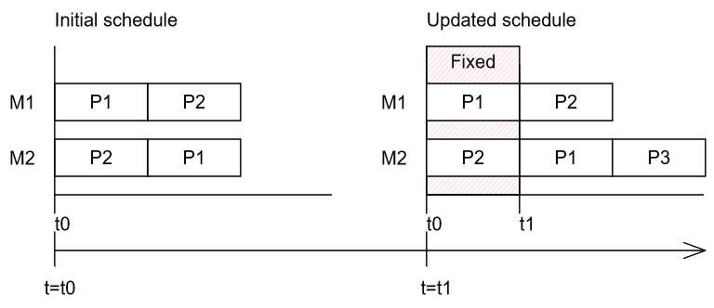








How to bring simulation-optimization to a real plant?
Schedules may become suboptimal or infeasible if disruptions occur
Minor disruptions
Small impact on the schedule
E.g., changes in start and end times
Core idea: Continuous improvement of schedules
The EA runs continuously
Model parameters and degrees of freedom of the EA are updated
Periodic updates at fixed time points
Event-driven updates after major disruptions
Updates of the degrees of freedom of the EA if the problem structure changes
Continuous generation of new schedules
Major disruptions
Large impact that may lead to infeasibility
E.g., rush orders, maintenance, failures
$$π_{1}=\{P01, P02, P03\}$$
$$π_{1}=\{P01, P04, P02, P03\}$$
$$π_{2}=\{P01, P03, P02\}$$
$$π_{2}=\{P01, P03, P04,P02\}$$
$$π_{3}=\{P03, P01, P02\}$$
$$π_{3}=\{P03, P01, P02,P04\}$$
$$t_{0}$$
$$t_{1}$$
Arrival of new order P04
Notes:
One of the main problems is that we have to deal with disruptive events. There are two kind of disruption. Minor disruptions usually don’t have a hugh impact on the predicited schedules. Events that fall under this category are changes in start and end times of operations, minor delays, and minor yield changes. One way to deal with these disruption is through periodic rescheduling. At fixed time intervals the scheduling system is update with the current plant state and reevaluated.

Slide 8
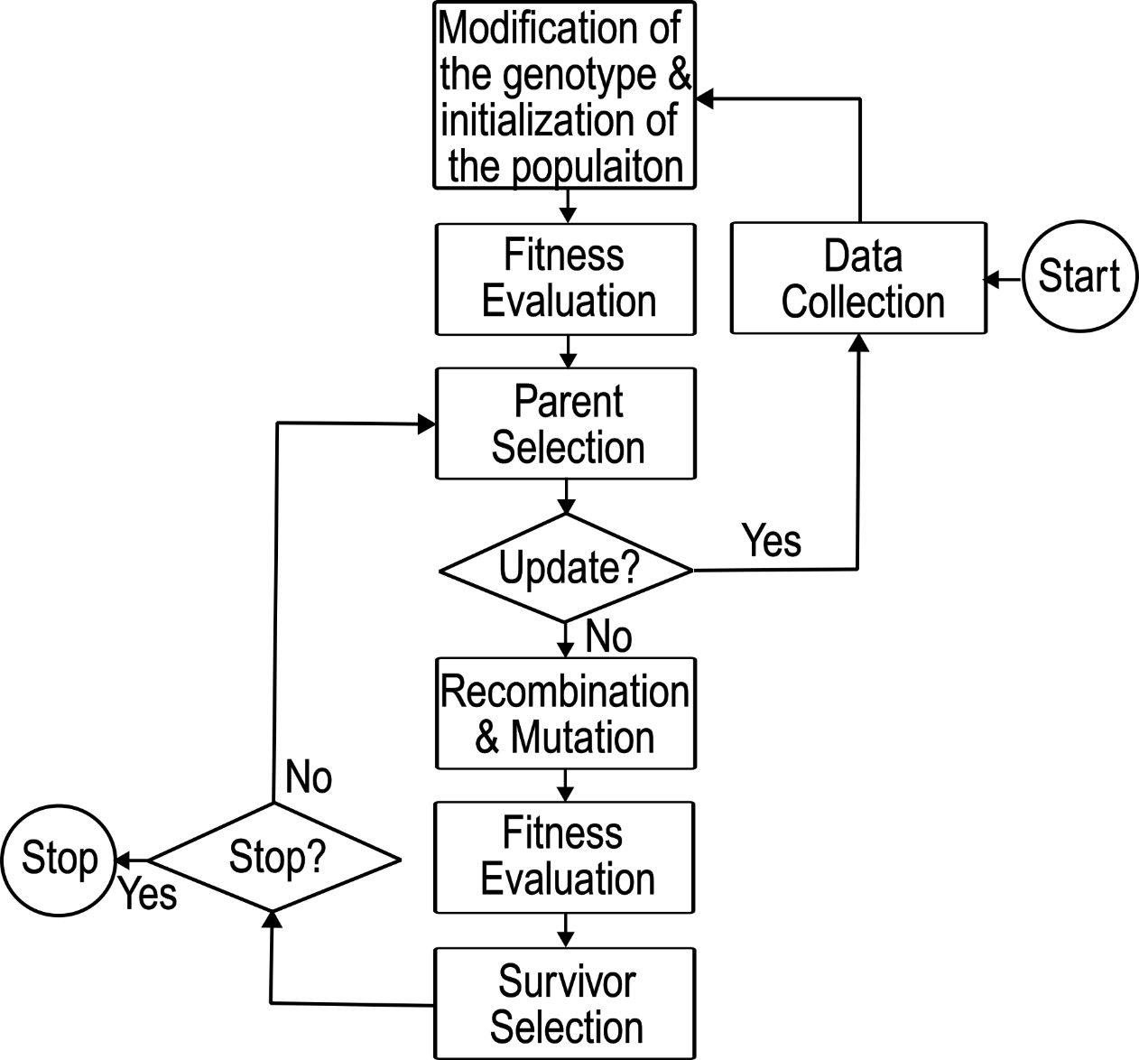


Reactive real-time scheduling framework
SCHEDULING SYSTEM
Evolutionary Algorithm
PRODUCTION SYSTEM
Modify genotypes
Order states → Sequence encoding =
$$π_{seq}=\left\{P1, P2, P3, …\right\}$$
Resource states → Allocation encoding =
$$π_{alloc}=\left\{P1:\left\{M1\right\}, P2:\left\{M1, M3\right\}, …\right\}$$
Control Center
Starts the EA
Parametrizes the EA
Triggers updates
Periodic
E.g., delays
Reactive
Rush orders
Maintenance
Encode genomes
Decisions & Predictions
Initial solutions
Last population as initial solutions
Fix genomes of the last population
Inject new degrees of freedom into genomes
E.g.,
$$π_{1}=\{P1, P2, P3\}$$
$\{P4\}$
$$π_{1,update}=\{P1, P4, P2, P3\}$$
Update trigger
Genomes
Decisions & Predictions
Decisions
Plant data
Discrete-event simulation
Decodes genomes
Evaluates schedules
Production plant
Execution of schedules
Generates plant data
Genomes

Slide 9
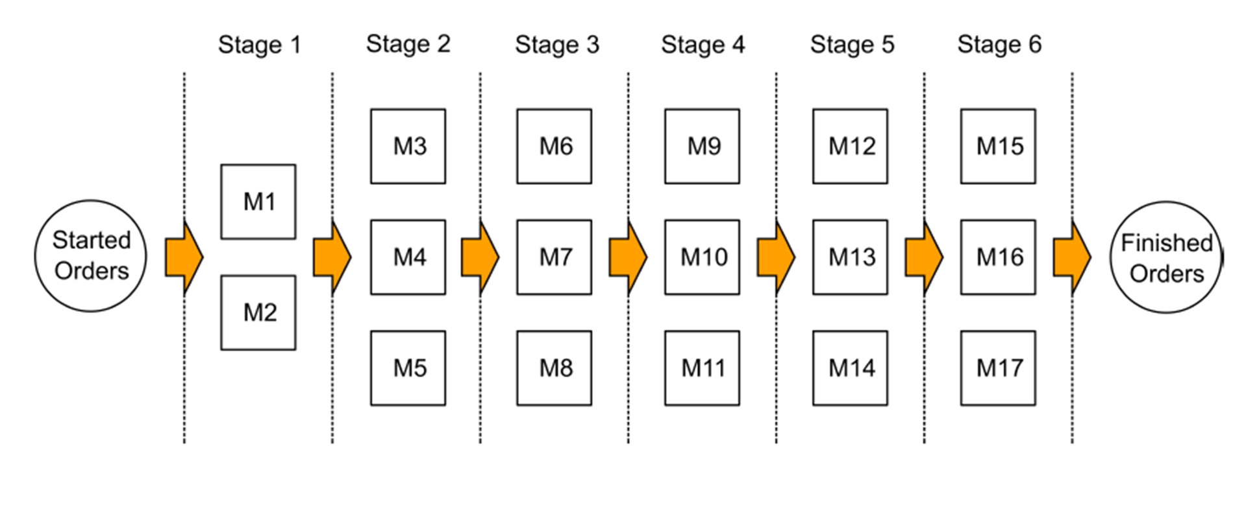
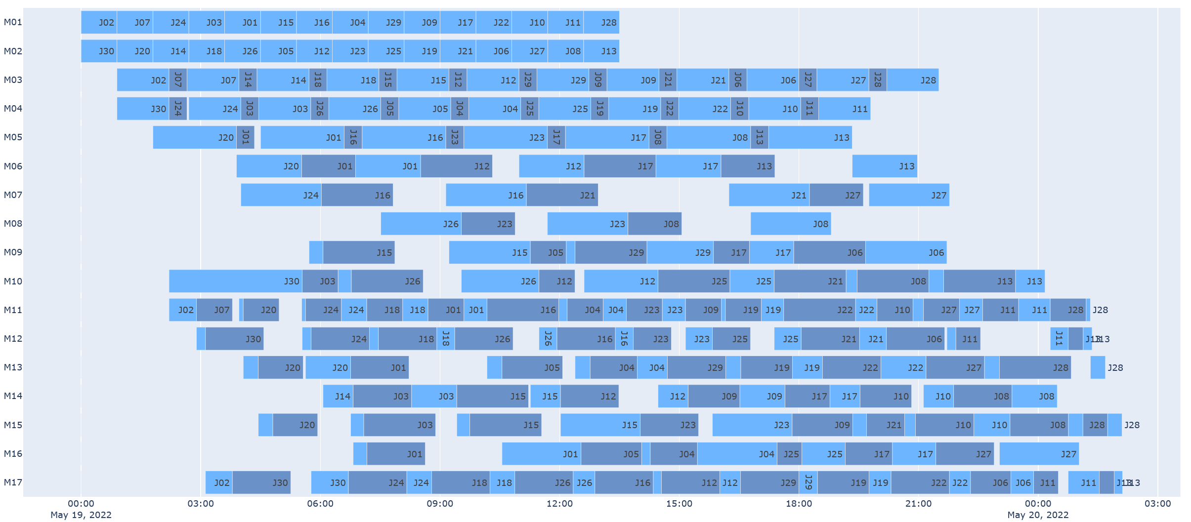
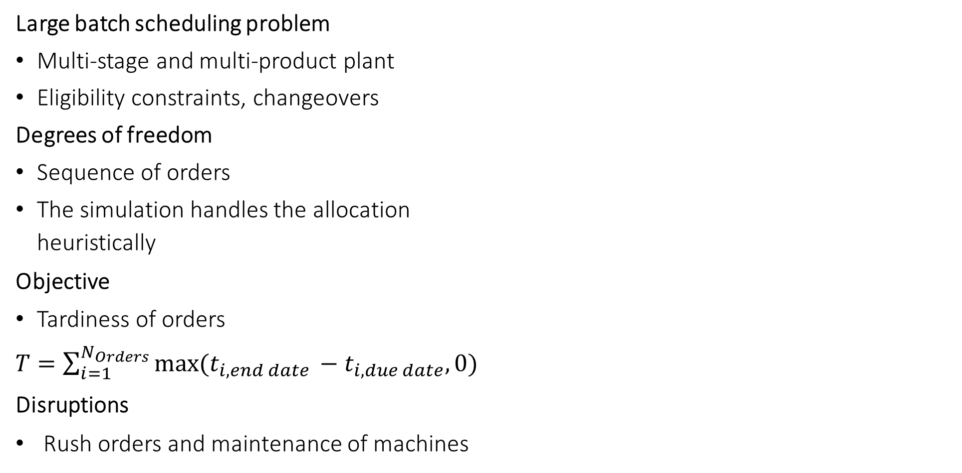
Pharmaceutical batch production process
Large batch scheduling problem
Multi-stage and multi-product plant
Eligibility constraints, changeovers
Degrees of freedom
Sequence of orders
The simulation handles the allocation heuristically
Objective
Tardiness of orders
$T=\sum_{i=1}^{N_{Orders}}{max⁡(t_{i,end date }−t_{i,due date},0)}$
Disruptions
Rush orders and maintenance of machines
[1] G. M. Kopanos, C. A. M´endez, L. Puigjaner, ”MIP-based decomposition strategies for large-scale scheduling problems in multiproduct multistage batch plants: A benchmark scheduling problem of the pharmaceutical industry,” European Journal of Operational Research,vol. 207, pp. 644?655, Dec. 2010.

Slide 10
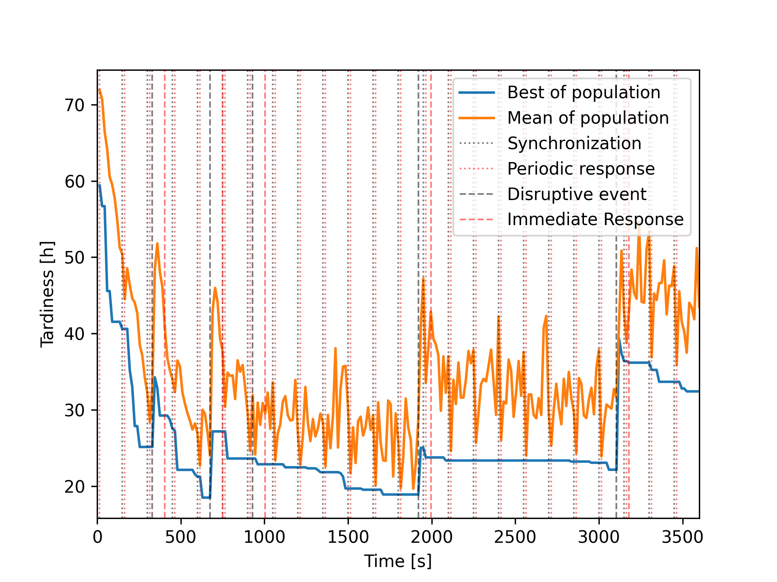
Simulation results
1 hour of plant operation
On average every 2.5 minutes an operation happens
The optimizer runs continuously
Events that have occurred are fixed in the simulation
Events are handled in real-time
15 seconds response time after periodic updates
150 seconds response time after major disturbances
Current population is maintained
Periodic Updates
At 3105 seconds
1h
2h
3h
4h
At 3255 seconds
1h
2h
3h
4h
Maintenance on machine “M1” for 3 h
Rush order “P01_Rush” of type “P01”
Duration change of maintenance on “M1” to 2.5 h
Rush order “P02_Rush” of type “P02”
Maintenance on machine “M3” for 3 h

Slide 11
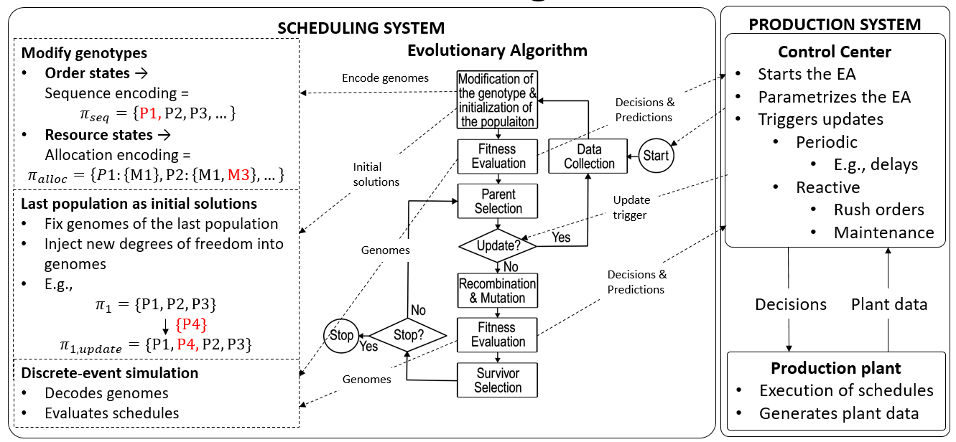
Kleinere Änderungen
Wie definiert?
Reactive Real-time Scheduling System
Updateintervall
Einfluss auf das System
Lösungsgüte
Widerstandsfähigkeit
Untersuchung von Design-Parameter
Rückmeldeintervall
Störungen
Delays
Ausfälle
Rush Order
Stochastisch
Deterministisch
Reproduzierbarkeit
Initialisierung von Lösungen
Updates
Parameter
Rechenzeit des EAs
Saubere Simulations- und Teststruktur
Parametrierbar
Updates (Struktur und Zeiten)
Rückmeldungen
Aufträge
Störungen
Zielfunktion
(Model)
(Simulator)
Referenzlösung
Claire-Voyant
Beste letzte Lösung
Absichern der statistischen Signifikanz
Untersuchung der System Eigenschaften
Ziel
Leitfaden

Slide 12
Abstract
We validate our approach using a multiproduct, multistage batch plant from the pharmaceutical industry, as in the work of Kopanos et al. [2], and demonstrate that it can generate high-quality solutions in the presence of new order arrivals and disturbances.
The results are compared with those provided by an idealized clairvoyant scheduler which has access to the full information before the schedule is computed.
The influence of the choice of the reaction time after a disturbance which involves a compromise between a fast reaction and better decisions in the immediate future is studied in detail.

Slide 13
Schwerpunkt ESCAPE2025
Immediate Response Time
Einfluss auf die Lösungsgüte
Synchronisation statisch oder dynamisch?
Breite der Population
Steuerung der Population über die Distanz der Lösungen?
Wie viele Szenarien?
Szenario 1: 4 Rush Order
Szenario 2: …
Stochastisch?
Claire-Voyant Vergleich

Slide 14
Ergebnisse
Kopanos Case Study
30 Aufträge
Tardiness oder Tardiness + Avg. Earliness
4 Rush Order -> Kann noch variiert werden
300 Sekunden response time -> Variieren
Distance Measure
Levenshtein Distance
Umwandlung der Zeichenketten ineinander
Parameter Control

Slide 15
Weitere Forschungsschwerpunkte (1/2)
Breite der Lösung des EAs kontrollieren -> GECCO 2025
Vergleich: Enge Verteilung mit guter Lösung <-> Breite Verteilung mit schlechter Lösung
Metrik erforderlich
Hamming Distance -> nicht geeignet, da die Sequenz nicht berücksichtigt wird.
Levenshtein Distance -> teilweise geeignet.
N-Gram -> Gut geeignet, wenn modifiziert.
Ab wann ist eine Immediat Response notwendig -> Heuristiken als IR
Quantifizieren der Störung
Situationsbedingtes handeln
Nervousness
E-Funktion über die Zeitachse als Penalty
Multi-objective ansatz
Rolling Horizon
Wie kann man Schedules bewerten

Slide 16
Weitere Forschungsschwerpunkte (2/2)
Parameterstudien
Modellkonfigurationen

Slide 17
Definition Stochastischer Störungen
Kleine Störungen
Operationszeiten
Dauer
Startzeit
Due Dates
Große Störungen
Operationszeiten
Dauer
Startzeit
Due Dates
Ausfälle
Maschinen
Aufträgen
Neue Aufträge
Maintenance

Slide 18
Untersuchung der Immediate Response Strategie
Anregung des Systems durch große Störungen
N neue Aufträge mit engen Due Dates zur gleichen Zeit (N= 1, …, 5)
Einfluss auf das System
Tardiness
Nervousness
Teststruktur:
Start mit einer guten Lösungen
Das System mit Störungen anregen
Ziel
Systemeigenschaften: Anzahl Störung <-> Einfluss <-> Dauer der Konvergenz
Zusammenhänge: Tardiness <-> Earliness (Slack) <-> Einfluss der Störungen
Lösungsgüte
Konvergenz
Untersuchung von Paramtern:
Größe der Population, Rückmeldeintervall, Earliness, Slack, Konvergenz, Nervousness

Slide 19
Design of Experiments
Anzahl
Einflussgrößen Systemgrößen Objectives
Art
Störungen
Impact
Zeitpunkt
Populationsgröße
Performanz
Nervousness
Earliness
Konvergenz
Tardiness
Tardiness
Initiallösung
Slack
Updateintervalls
Widerstand
Claire-Voyant

Slide 20
Untersuchungen
Einfluss der Störungen auf die Performanz und Kovergenz
Quantifizierung der Störungen?
(Bei Delays wichtig: Ab wann ist eine Immediate Response notwendig?)
Einfluss der Populationsgröße auf die Widerstandsfähigkeit und Kovergenz
Einfluss der Initiallösung auf die Widerstandsfähigkeit und Kovergenz
Earliness, Slack
Entwicklung der Nervousness und Tardiness (Multiobjective Ansatz)
Abweichungen der Lösungen durch Vergleich der Reihenfolgen der Operationen
z.B.: M1: [P1,P2,P3,P4] M2:[P1,P2,P3_Rush, P3, P4]
Jede Abweichung erhöht die Tardiness
Aufsummieren der Abweichungen
Parallel zur Tardiness Plotten
Einfluss der Earliness auf die Widerstandsfähigkeit und Kovergenz
Absorbtionsfähigkeit des Systems
Wieviele Störungen verkraftet das System?
Einfluss des Updateintervalls auf die Lösungsgüte und Konvergenz

Slide 21
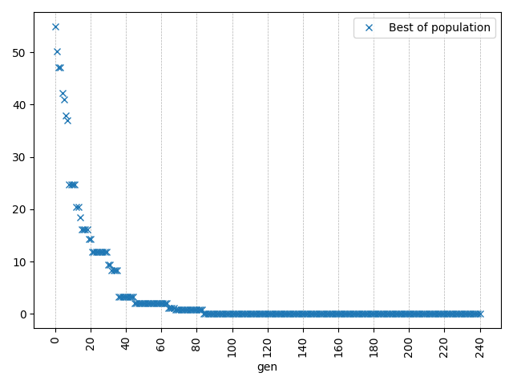
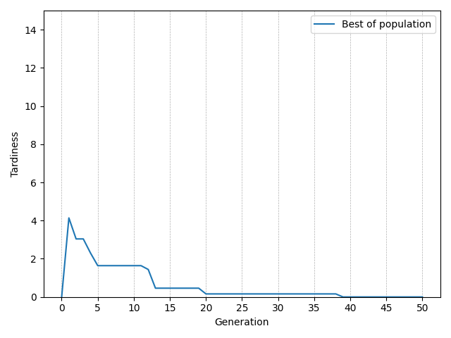
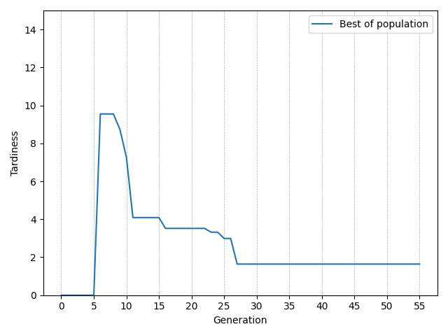
Start mit Initiallösung:
2 Rush Order
4 Rush Order

Slide 22
PaperCept Conference Management System
I hope you're doing well. We are excited to announce that submissions are now open for two special issues dedicated to CoDIT 2024. Through this email, we strongly encourage you, as an author of a selected paper presented at the IEEE/IFAC CoDIT 2024 (https://codit2024.com/),to submit an extended version of your work.
The CFP for the two special issues are available here:
Optimization and Engineering Journal (Impact Factor:2.0) (Deadline 15. Nov)
https://link.springer.com/collections/fbjebdiaje
RAIRO - Operations Research (Impact Factor: 1.8) (Deadline 15. Dez)
https://www.rairo-ro.org/news/287-call-for-papers-special-issue-on-innovative-approaches-in-decision-and-optimization-theory-and-applications-perspective-codit-2024
Additionally, we will soon share the CFPs for two more special issues.

Slide 23
Untersuchung des Updateintervalls
Änderung der Operationszeiten
Annahme: Updateinterval proportional zur durschnittlichen Zeit zwischen Operationen
Ist die Annahme gerechtfertigt?
Änderung der Modelle
2X2, 3X3, 4X4 (Maschinen X Stages)
Anzahl der Orders und Störungen
Sind die Ergebnisse der Untersuchungen der Immediate Response Strategie übertragbar?

Slide 24
Conclusions and outlook
A new approach to real-time scheduling is proposed
Based on simulation-optimization with detailed simulation models
Updates the simulation model and the genotypes of the EA and continuously runs the optimization
The performance was demonstrated for a complex pharmaceutical production example
Outlook
Rolling-horizon approach
Reducing scheduling nervousness

Slide 25
Anforderungen an die Simulation ausarbeiten
Initialisierbar
Parametrisierbar
Dynamische Rezepte
Muss ein neuer Simualtionsansatz entwickelt werden?
Stateful Discrete Event Simulations

Slide 26
Thank you!

Slide 27
Backup

Slide 28
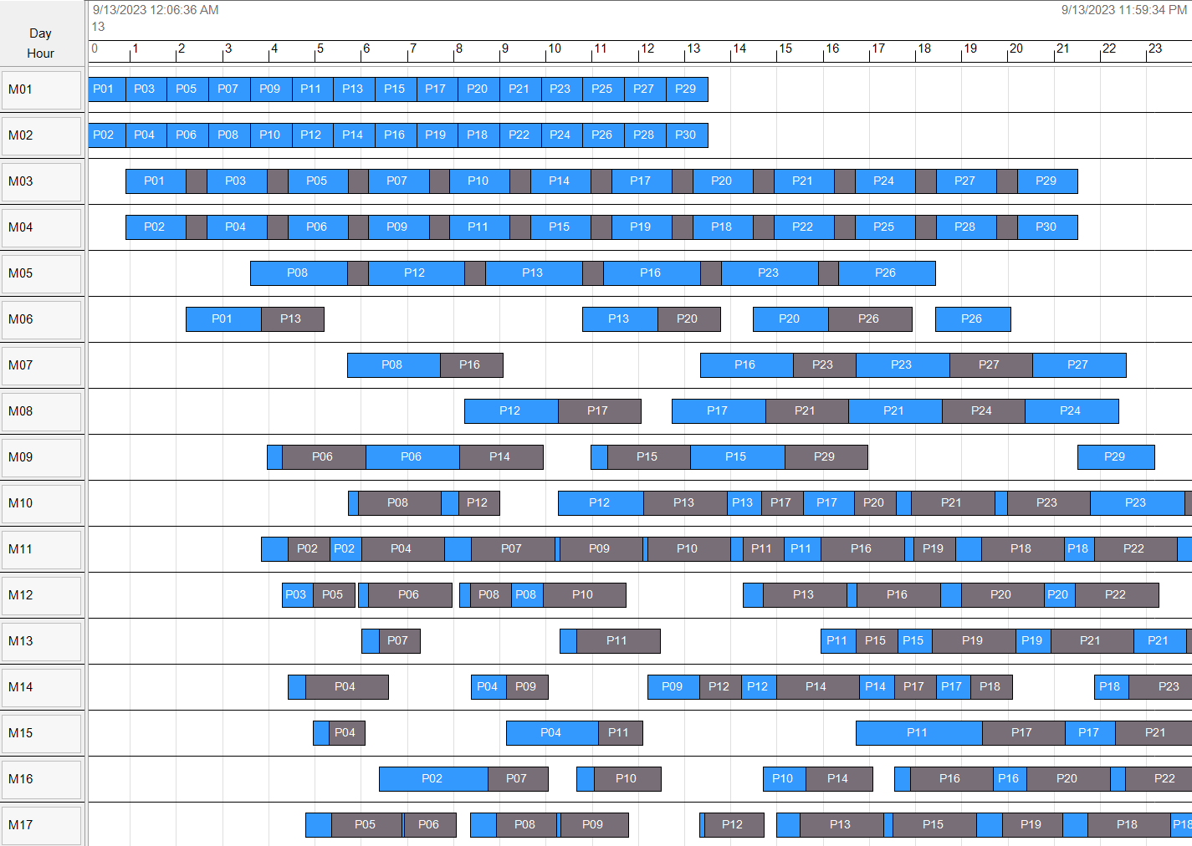
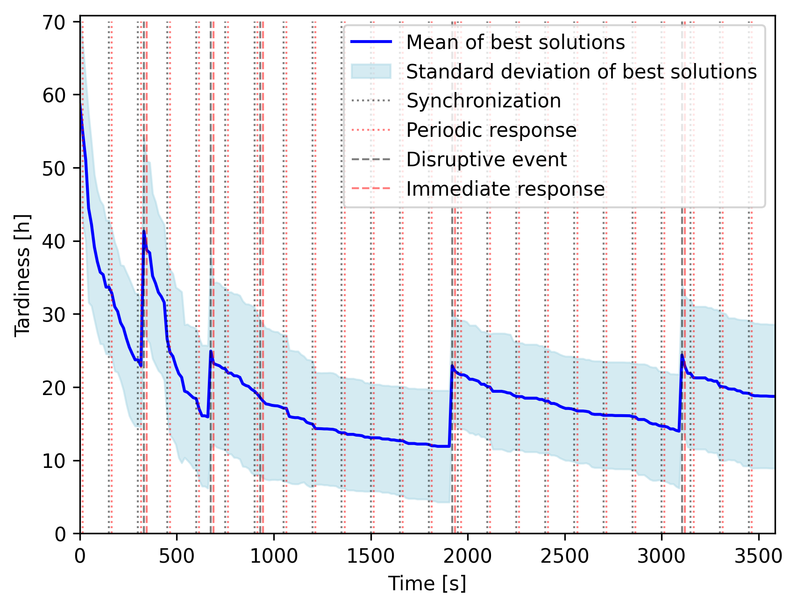
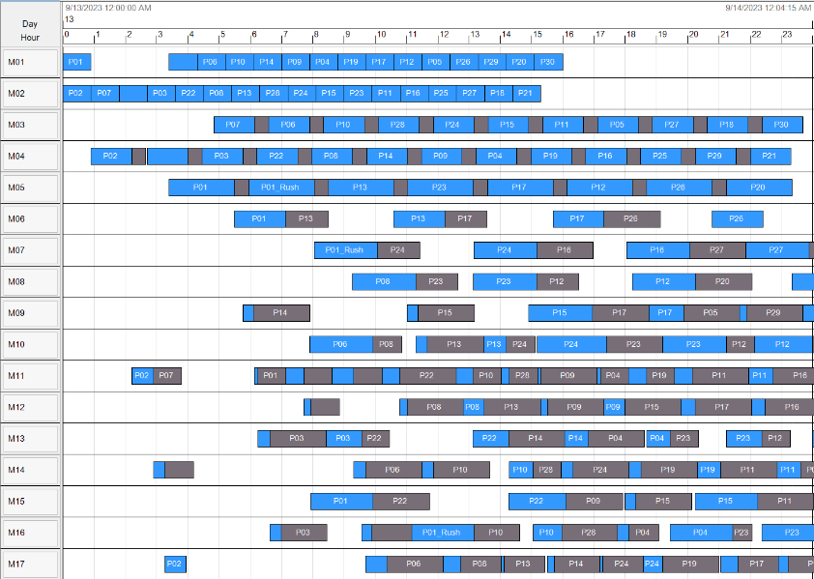
Results of different simulation runs

